Slide 1
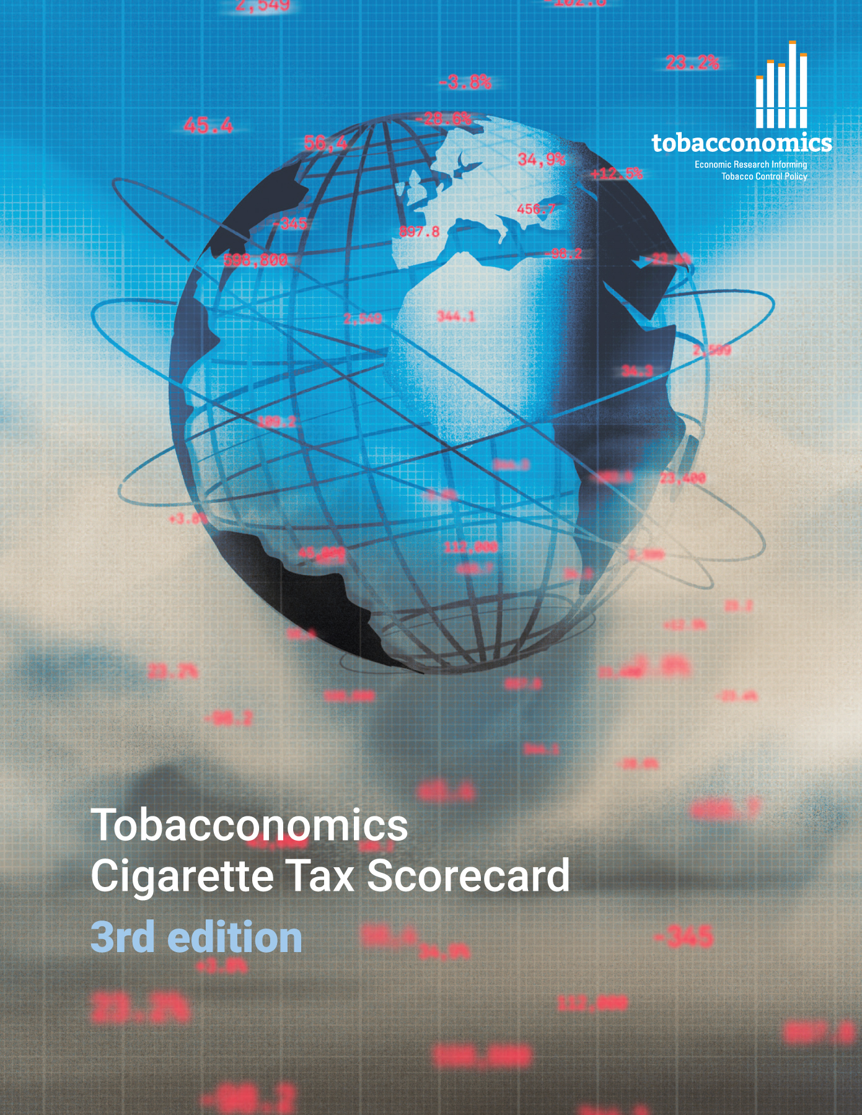
Cigarette tax policies in Burkina Faso, 2022
4 key tax components were assessed using a 5-point scale, with the overall score reflecting an average of Burkina Faso’s component scores.
The scores reflect the current strengths and opportunities in Burkina Faso to further increase tax revenue and improve health.
OPPORTUNITY
for improvement
www.tobacconomics.org | @tobacconomics | Tobacconomics Cigarette Tax Scorecard (3rd edition)

Slide 2
How does Burkina Faso compare to other countries?
Burkina Faso’s overall score in 2022 is compared to the average overall scores in its income group, region, the world, and top performers.
www.tobacconomics.org | @tobacconomics | Tobacconomics Cigarette Tax Scorecard (3rd edition)

Slide 3
How does Burkina Faso compare to other countries?
The components of Burkina Faso’s score in 2022 are compared to component scores in the region, income group, world, and top performers.
AFFORDABILITY CHANGE
requires the most improvement.
www.tobacconomics.org | @tobacconomics | Tobacconomics Cigarette Tax Scorecard (3rd edition)

Slide 4
Burkina Faso’s cigarette tax policies over time
Burkina Faso's overall score increased significantly in 2018 with a decrease in 2020 due to a failure to reduce affordability over time. Other component scores remained unchanged in 2022.
www.tobacconomics.org | @tobacconomics | Tobacconomics Cigarette Tax Scorecard (3rd edition)

