Slide 1
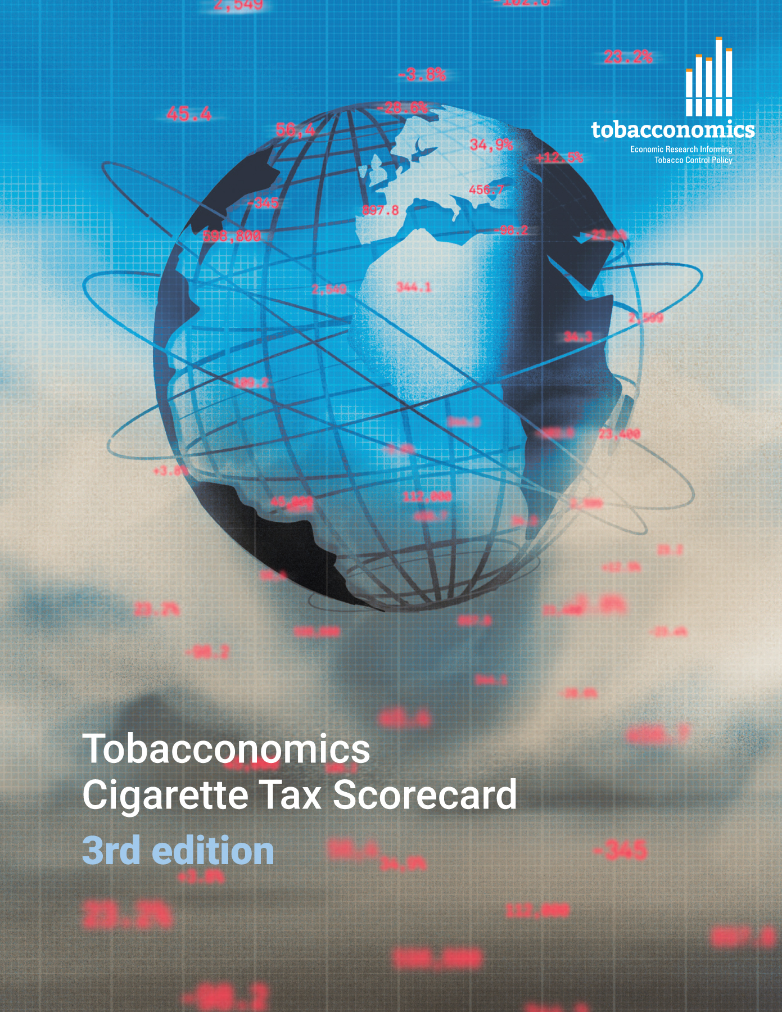

Cigarette tax policies in Bangladesh, 2022
  4 key tax components were assessed using a 5-point scale, with the overall score reflecting an average of Bangladesh’s component scores.
  The scores reflect the current strengths and opportunities in Bangladesh to further increase tax revenue and improve health.
OPPORTUNITY
for improvement
www.tobacconomics.org | @tobacconomics | Tobacconomics Cigarette Tax Scorecard (3rd edition)

Slide 2
How does Bangladesh compare to other countries?
  Bangladesh’s overall score in 2022 is compared to the average overall scores in its income group, region, the world, and top performers.
www.tobacconomics.org | @tobacconomics | Tobacconomics Cigarette Tax Scorecard (3rd edition)

Slide 3
How does Bangladesh compare to other countries?
  The components of Bangladesh’s score in 2022 are compared to component scores in the region, income group, world, and top performers.
AFFORDABILITY CHANGE
requires the most improvement.
www.tobacconomics.org | @tobacconomics | Tobacconomics Cigarette Tax Scorecard (3rd edition)

Slide 4
Bangladesh’s cigarette tax policies over time
  Bangladesh’s overall score dropped from 2020 to 2022, largely due to a failure to decrease affordability of cigarettes.
www.tobacconomics.org | @tobacconomics | Tobacconomics Cigarette Tax Scorecard (3rd edition)

