Slide 1
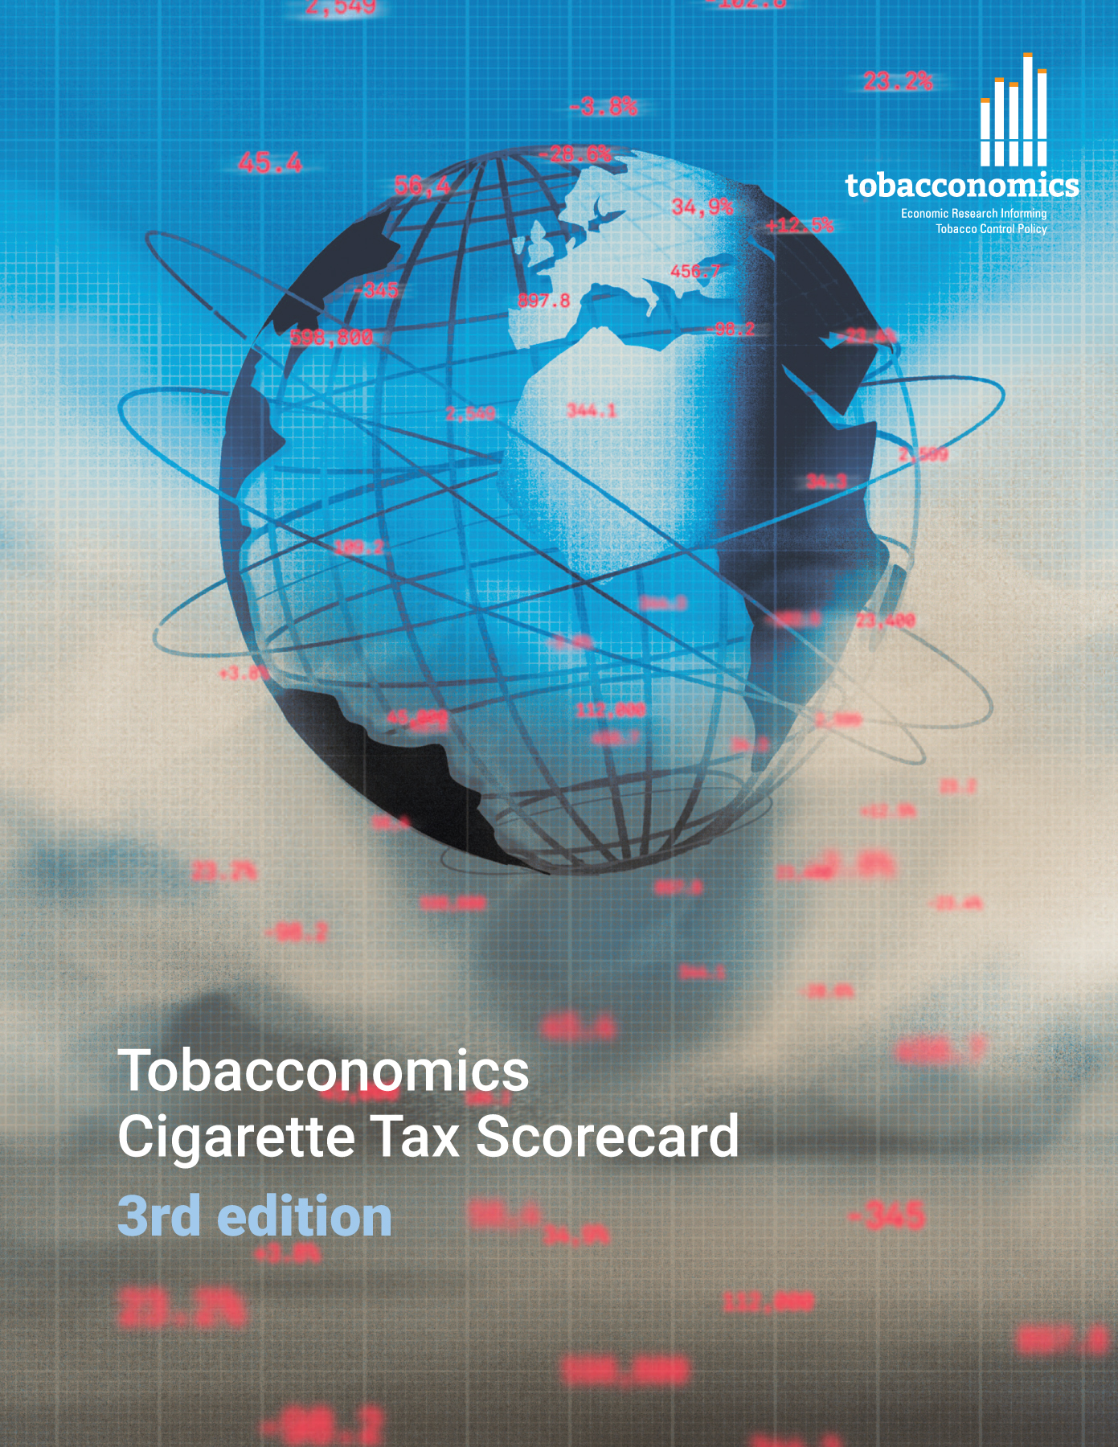

Cigarette tax policies in Bosnia and Herzegovina, 2022
  4 key tax components were assessed using a 5-point scale, with the overall score reflecting an average of Bosnia and Herzegovina’s component scores.
  The scores reflect the current strengths and opportunities in Bosnia and Herzegovina to further increase tax revenue and improve health.
OPPORTUNITY
for improvement
www.tobacconomics.org | @tobacconomics | Tobacconomics Cigarette Tax Scorecard (3rd edition)

Slide 2
How does Bosnia and Herzegovina compare to other countries?
  Bosnia and Herzegovina’s overall score in 2022 is compared to the average overall scores in its income group, region, the world, and top performers.
www.tobacconomics.org | @tobacconomics | Tobacconomics Cigarette Tax Scorecard (3rd edition)

Slide 3
How does Bosnia and Herzegovina compare to other countries?
  The components of Bosnia and Herzegovina’s score in 2022 are compared to component scores in the region, income group, world, and top performers.
AFFORDABILITY CHANGE
requires the most improvement.
www.tobacconomics.org | @tobacconomics | Tobacconomics Cigarette Tax Scorecard (3rd edition)

Slide 4
Bosnia and Herzegovina’s cigarette tax policies over time
  Bosnia and Herzegovina’s overall score declined since 2018 due to a failure to reduce affordability over time and a decrease in cigarette prices.
www.tobacconomics.org | @tobacconomics | Tobacconomics Cigarette Tax Scorecard (3rd edition)

