Slide 1
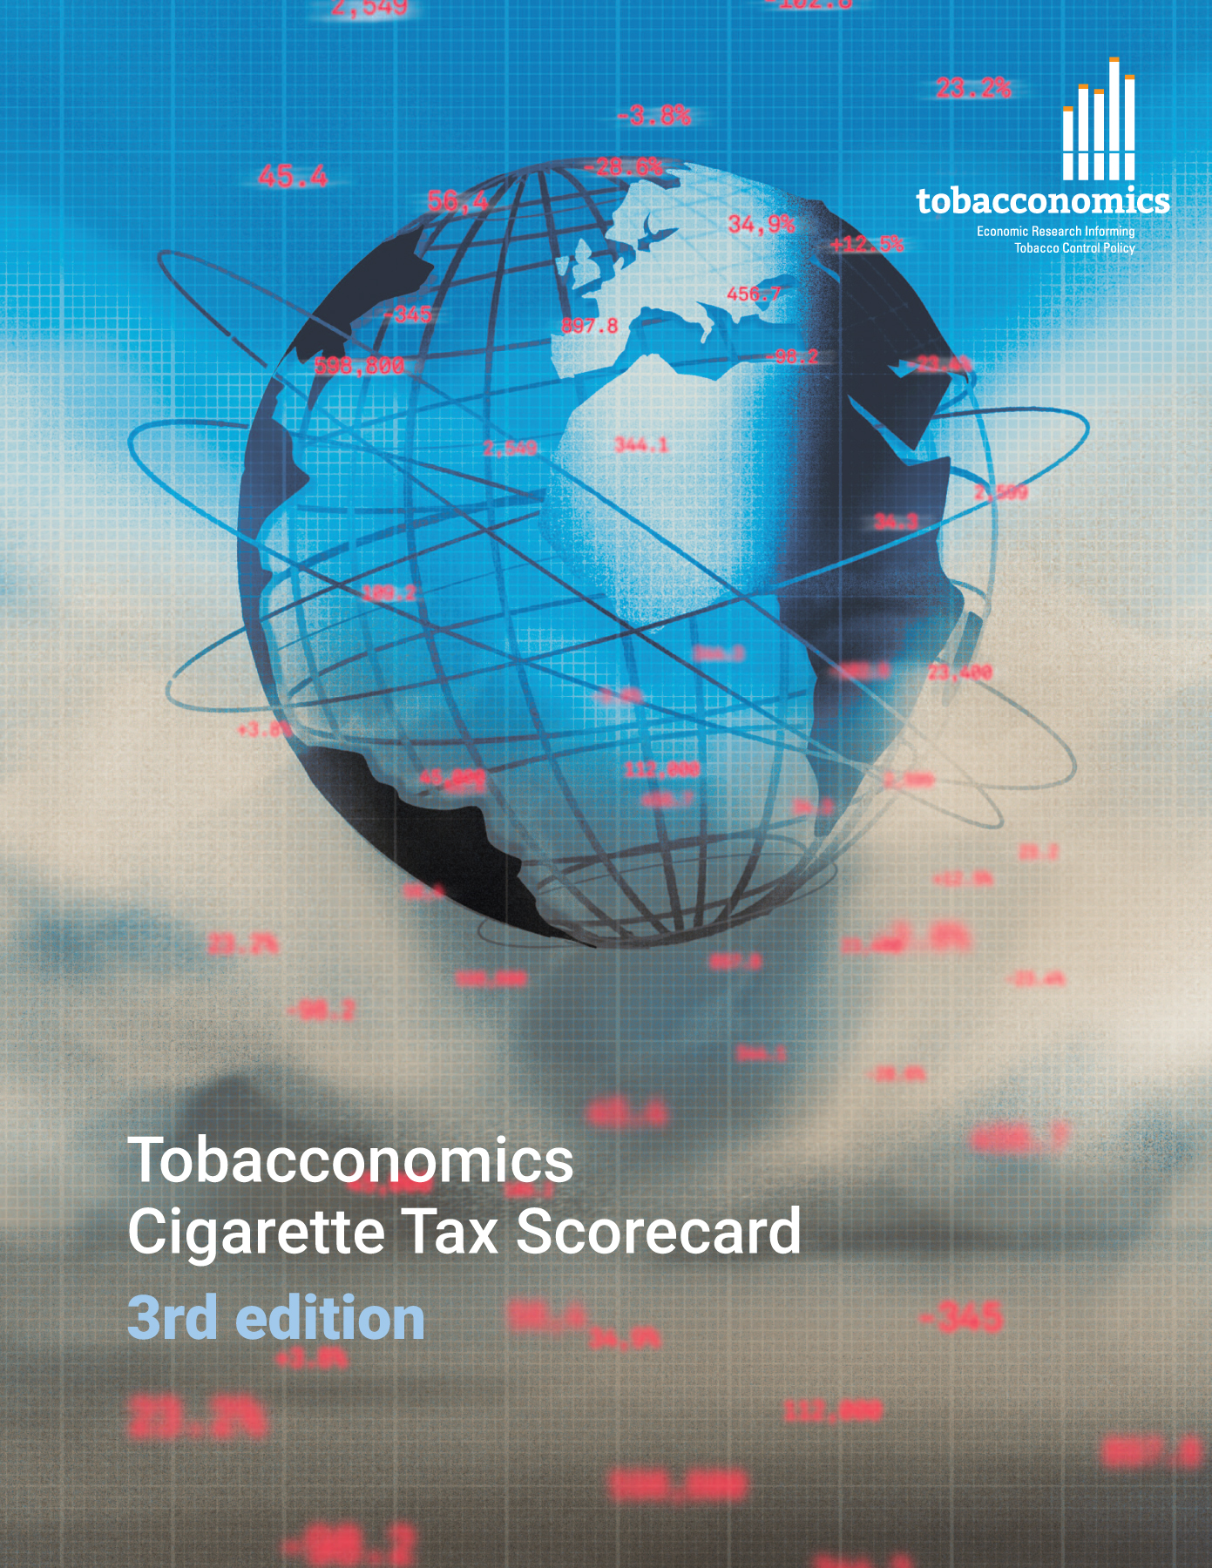

Cigarette tax policies in Azerbaijan, 2022
4 key tax components were assessed using a 5-point scale, with the overall score reflecting an average of Azerbaijan’s component scores.
The scores reflect the current strengths and opportunities in Azerbaijan to further increase tax revenue and improve health.
OPPORTUNITY
for improvement
www.tobacconomics.org | @tobacconomics | Tobacconomics Cigarette Tax Scorecard (3rd edition)

Slide 2
How does Azerbaijan compare to other countries?
Azerbaijan’s overall score in 2022 is compared to the average overall scores in its income group, region, the world, and top performers.
www.tobacconomics.org | @tobacconomics | Tobacconomics Cigarette Tax Scorecard (3rd edition)

Slide 3
How does Azerbaijan compare to other countries?
The components of Azerbaijan’s score in 2022 are compared to component scores in the region, income group, world, and top performers.
CIGARETTE PRICE
requires the most improvement.
www.tobacconomics.org | @tobacconomics | Tobacconomics Cigarette Tax Scorecard (3rd edition)

Slide 4
Azerbaijan’s cigarette tax policies over time
Azerbaijan's overall score increased before falling again between 2014 and 2020 due to the large increase and drop in the affordability change score.
www.tobacconomics.org | @tobacconomics | Tobacconomics Cigarette Tax Scorecard (3rd edition)

