Slide 1
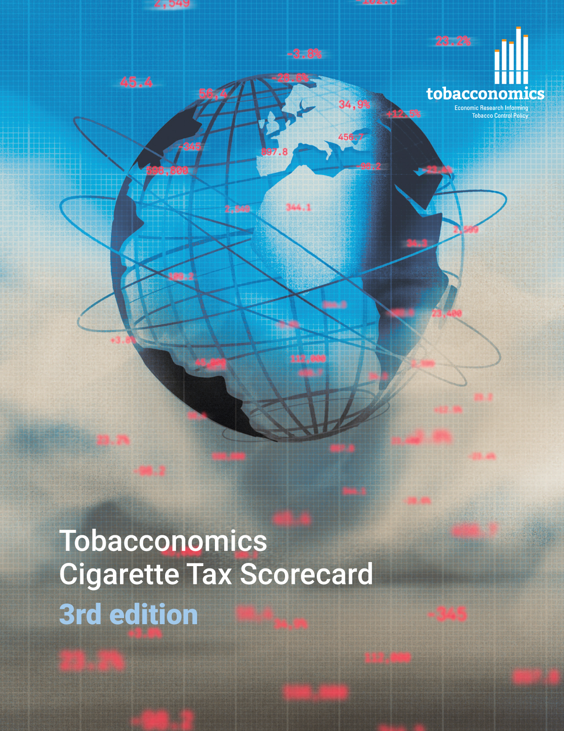
Cigarette tax policies in Argentina, 2022
4 key tax components were assessed using a 5-point scale, with the overall score reflecting an average of Argentina’s component scores.
The scores reflect the current strengths and opportunities in Argentina to further increase tax revenue and improve health.
OPPORTUNITY
for improvement
www.tobacconomics.org | @tobacconomics | Tobacconomics Cigarette Tax Scorecard (3rd edition)

Slide 2
How does Argentina compare to other countries?
Argentina’s overall score in 2022 is compared to the average overall scores in its income group, region, the world, and top performers.
www.tobacconomics.org | @tobacconomics | Tobacconomics Cigarette Tax Scorecard (3rd edition)

Slide 3
How does Argentina compare to other countries?
The components of Argentina’s score in 2022 are compared to component scores in the region, income group, world, and top performers.
AFFORDABILITY CHANGE
requires the most improvement.
www.tobacconomics.org | @tobacconomics | Tobacconomics Cigarette Tax Scorecard (3rd edition)

Slide 4
Argentina’s cigarette tax policies over time
Argentina’s overall score largely stayed the same, although it decreased slightly from 2020 to 2022 due to a decrease in cigarette prices.
www.tobacconomics.org | @tobacconomics | Tobacconomics Cigarette Tax Scorecard (3rd edition)

