Slide 1
Taxing E-Cigarettes: An Overview of the Goals and Challenges States Face
Frank J. Chaloupka, University of Illinois at Chicago
Nicotine Dependence Center & National Summit on Smokeless Tobacco Prevention 2020, October 19

Slide 2

Overview
Impact of prices on demand for ENDS
Current taxation of ENDS
    Tax structures
    Taxes on vaping solutions
    Taxes on vaping devices
www.tobacconomics.org | @tobacconomics

Slide 3
Demand for ENDS

Slide 4
www.tobacconomics.org | @tobacconomics

Slide 5
www.tobacconomics.org | @tobacconomics

Slide 6
Impact of Price on ENDS
General Conclusions:
  ENDS demand is highly responsive to price
    More responsive to price than cigarette demand
  Youth ENDS demand more responsive to price than youth cigarette demand
  Growing evidence of substitution between cigarettes and ENDS
  Need for more research given data limitations and rapidly evolving markets
www.tobacconomics.org | @tobacconomics

Slide 7
Taxing ENDS

Slide 8
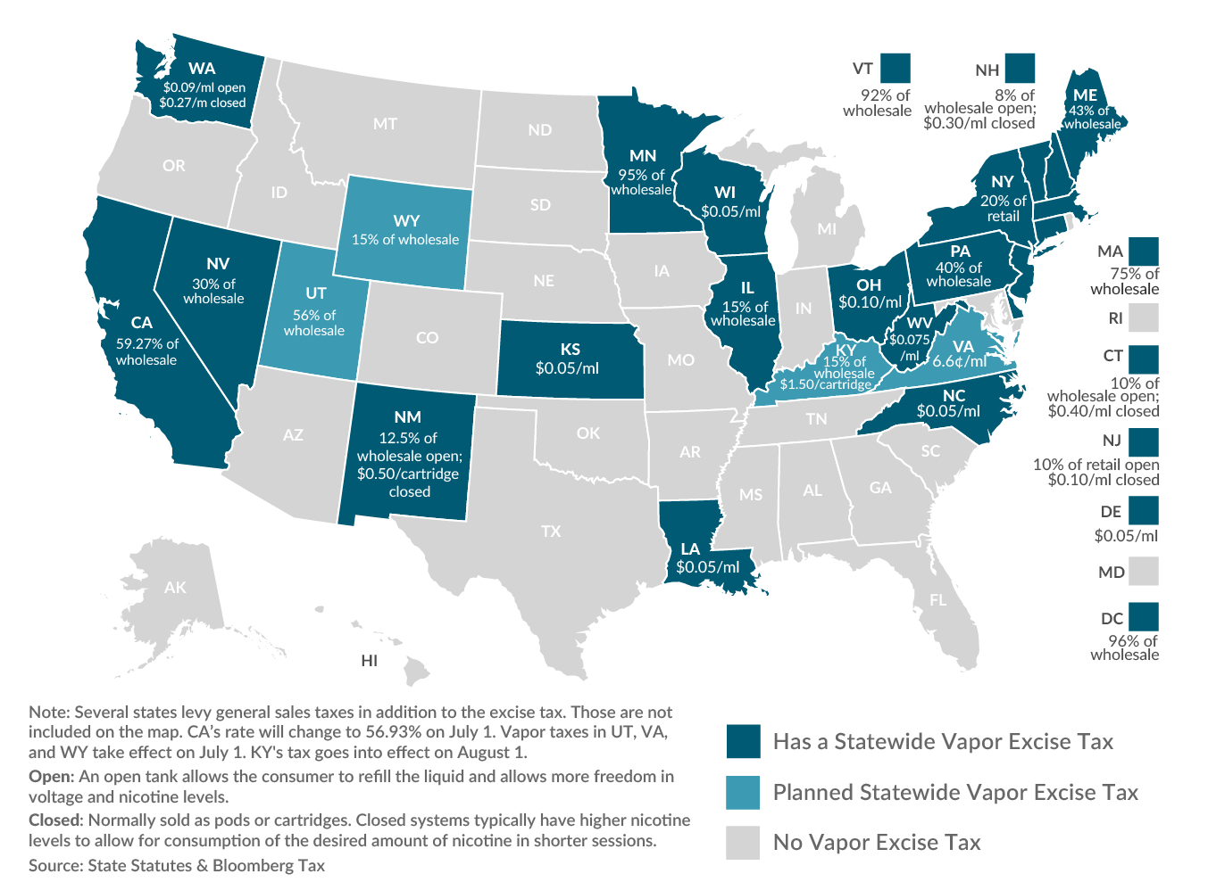
State ENDS Taxes – June 2020
www.tobacconomics.org | @tobacconomics
Source: Tax Foundation, 2020

Slide 9
www.tobacconomics.org | @tobacconomics

Slide 10
Tax Structure

Slide 11
Taxing ENDS
Question: Ad valorem or specific tax?
    Some apply ad valorem tax
      AK-Junea, MatSu Borough; CA; DC; IL; ME; MD; MN; NV; NY; PA
    Many others apply specific
      Cook County IL, DE, KS, LA, NC, OH, WA, WV, WI
    Some apply mixed or differential tax
      Chicago: specific tax per unit ($1.50) AND specific tax based on volume of vaping solution ($1.20/ml)
      New Jersey: $0.10/ml nicotine liquid OR 10% retail price for container e-liquids
      New Mexico: 12.5% of manufacturer price for nicotine liquid OR $0.50/cartridge
      Washington: $0.27/ml (≤ 5ml container) OR $0.09/ml (>5 ml container)
      Others including CT, GA, KY, NH
www.tobacconomics.org | @tobacconomics

Slide 12
Taxing ENDS
Question: If ad valorem, applied on what price?
    Few apply on retail price (NY)
    Few apply to manufacturer price (UT)
    Most apply to wholesale/distributor price
  Recommendation: apply ad valorem tax based on tax-inclusive retail price
    Accounts for wide variety of available vaping products
    Accounts for non-traditional distribution chain for many vaping products
www.tobacconomics.org | @tobacconomics

Slide 13
Taxing Solutions Used in ENDS

Slide 14
Taxing ENDS Liquids
Question: Tax all liquids or just those that contain nicotine?
    A few tax any liquid used for vaping
    Others tax only liquids containing nicotine
      Most U.S. states/localities
  Recommendation: tax all liquids used in vaping
      Eliminates need for taxing authority to determine whether or not product contains nicotine
www.tobacconomics.org | @tobacconomics

Slide 15
Taxing ENDS Liquids
Question: Differential tax based on nicotine content?
    US states/localities apply same tax regardless of nicotine content
    Some countries apply differential tax based on nicotine content
      Italy: €0.082074/ml if contains nicotine; €0.041037/ml if no nicotine
      Latvia: €0.01/ml plus €0.005/mg nicotine
  Recommendation: do not tax based on nicotine content
      Simplifies tax administration by eliminating need for taxing authority to determine nicotine concentration
www.tobacconomics.org | @tobacconomics

Slide 16
Taxing ENDS Liquids
Question: Tax products with any nicotine or with nicotine derived from tobacco?
    Unclear for most US states/localities
    Some clearly apply to only nicotine derived from tobacco
      Minnesota: originally applied its definition of other tobacco products, which includes products containing nicotine derived from tobacco
  Recommendation: if taxing only products containing nicotine, tax all regardless of source of nicotine
      Eliminates need for taxing authority to determine whether or not nicotine is derived from tobacco, other plants, or synthetic
www.tobacconomics.org | @tobacconomics

Slide 17
Taxing ENDS
Devices

Slide 18
Taxing ENDS Devices
Question: Tax devices/components or not?
    Many governments do not apply unique tax on devices
    Some do tax devices:
      Several US states/localities: ‘any product containing or delivering nicotine’
    A few with ad valorem taxes apply to devices only if they include vaping solution:
      California (59.27%) and Illinois (15%) of wholesale price for nicotine liquid or product containing nicotine liquid
      Minnesota: 95% of wholesale price (but trying to separately determine value of liquid only)
  Recommendation: do not tax devices/components
      Adds complications to tax administration, given diversity of devices and ability of users to make their own
      If ad valorem, then tax devices that contain vaping solution (e.g. disposable e-cigarettes, starter kits)
www.tobacconomics.org | @tobacconomics

Slide 19
Taxing ENDS
-
Other Issues

Slide 20
Taxing ENDS
Question: Where to collect?
    Manufacturer/Importer?
    Distributor?
    Retailer?
    Varied approaches in different jurisdictions
    Complicated by non-traditional distribution chains
      Many products go directly from manufacturer or importer to retailer
      Retailer can also be manufacturer
      Significant share of online sales
  Recommendation – collect taxes from retailers, including online vendors
    addresses challenges associated with non-traditional distribution chains
www.tobacconomics.org | @tobacconomics

Slide 21
Taxing ENDS
Question: What tax rate/level?
  Enormous variability in tax rates
    In U.S., specific taxes range from $0.05/ml (DE, KS, LA, NC, WI) to $1.20/ml + $1.50/unit in Chicago; ad valorem range from 15% (IL) to 96% (DC)
  Considerable variability relative to taxes on cigarettes
    Some governments aim to tax equivalently (e.g. CA, MN)
    Most tax at lower rates
    Rationale for relative rates unclear
Recommendation – tax equivalent to cigarettes
    If/when evidence is clearer on relative harms from ENDS vs. cigarettes, then potential for differential taxation to reflect relative risks
www.tobacconomics.org | @tobacconomics

Slide 22
Taxing ENDS
Question: What is the revenue potential?
  Revenue replacement often used as argument for taxing ENDS/ENNDS
  But revenue potential is small in most jurisdictions
    Relatively low use compared to cigarettes
    Revenue data very difficult to obtain
    Where data are available, suggest that revenues are minimal
      CA: nearly $1.9 billion from cigarette taxes vs. ~$32 million from vaping taxes
      MN: $525 million from cigarettes; $11 million from vaping taxes
Recommendation – if revenue generation/replacement is objective, raise taxes on cigarettes
www.tobacconomics.org | @tobacconomics

Slide 23
Summary

Slide 24
Summary
Demand for ENDS highly sensitive to price
    Increases in prices resulting from new/higher ENDS taxes would significantly reduce ENDS use
      But some substitution back to cigarettes
Increasing number of governments taxing ENDS
    Wide variety of tax structures and tax rates
    Little evidence on experiences with implementing and/or collecting taxes
    ‘Best Practices’ in ENDS taxation unclear and likely to change as products evolve
    Strong product regulation would ease challenges in taxing ENDS
www.tobacconomics.org | @tobacconomics

Slide 25
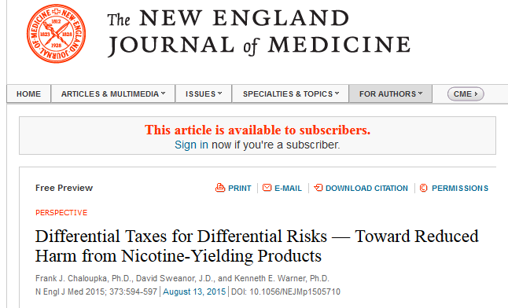
www.tobacconomics.org
@tobacconomics
fjc@uic.edu

