Slide 1
The Truth About
Tobacco Economics
Frank J. Chaloupka, University of Illinois at Chicago
Informational Briefing – Seeking Solutions to End the Youth Vaping Epidemic
Honolulu, Hawaii, October 17, 2019

Slide 2
Overview
Impact of taxes/prices on tobacco use
Economic counterarguments – Myths & Facts
Taxation of vaping products
www.tobacconomics.org

Slide 3
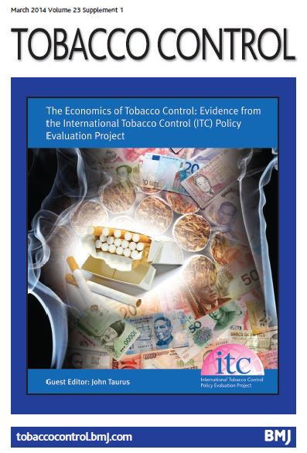

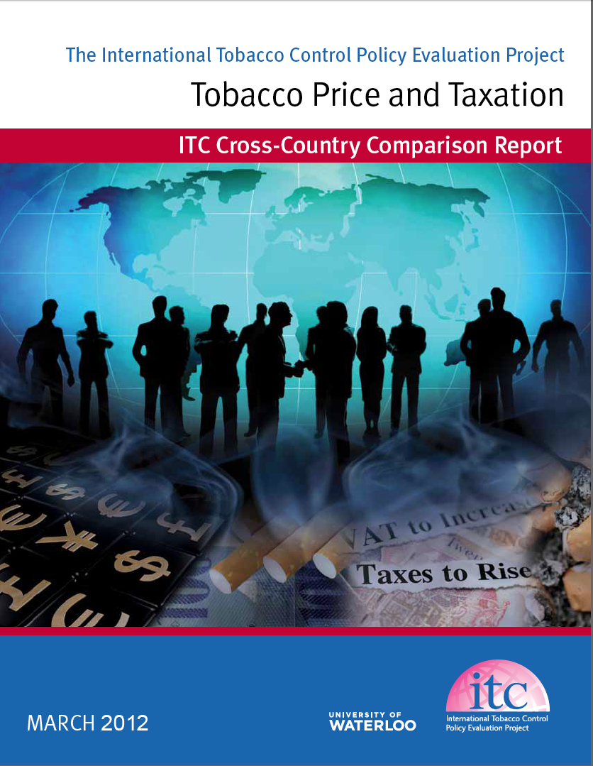
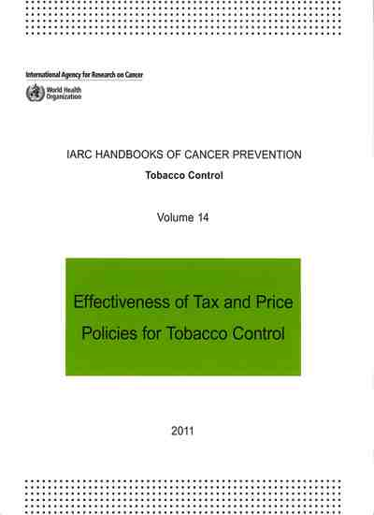
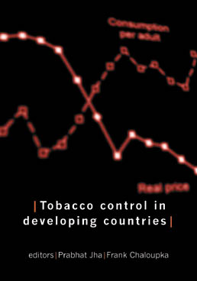
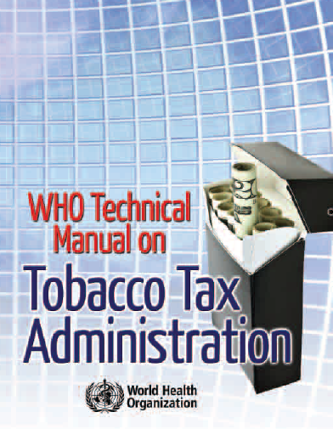

www.tobacconomics.org
Notes:
Large and growing evidence base on the economics of tobacco and tobacco control
In the process of finalizing joint NCI/WHO monograph that summarizes/synthesizes this evidence and provides the base for our presentation

Slide 4
Impact of Tax and Price on Tobacco Use

Slide 5


"Sugar, rum, and tobacco, are commodities which are no where necessaries of life, which are become objects of almost universal consumption, and which are therefore extremely proper subjects of taxation.
www.tobacconomics.org | @tobacconomics

Slide 6
Source: Tax Burden on Tobacco, 2019, and author’s calculations
www.tobacconomics.org | @tobacconomics

Slide 7
Source: Tax Burden on Tobacco, 2019, and author’s calculations
www.tobacconomics.org | @tobacconomics

Slide 8
Source: NHIS, Tax Burden on Tobacco, 2019, and author’s calculations
Note: some early years for prevalence are interpolated assuming linear trend
www.tobacconomics.org | @tobacconomics

Slide 9
www.tobacconomics.org | @tobacconomics

Slide 10
Source: BRFSS, Tax Burden on Tobacco, 2010, and author’s calculations
www.tobacconomics.org | @tobacconomics

Slide 11
Source: MTF, Tax Burden on Tobacco, 2019, and author’s calculations
www.tobacconomics.org | @tobacconomics

Slide 12
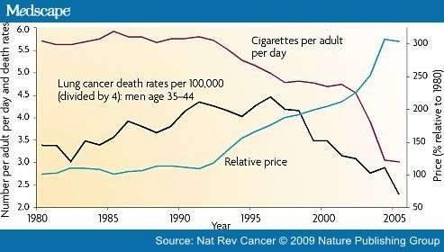
Taxes, Prices and Health: US, 1980-2005
www.tobacconomics.org | @tobacconomics

Slide 13
Prices and Tobacco Use
  Similar evidence for variety of other tobacco products
    Generally see evidence of substitution
    Greater substitution among more similar products
www.tobacconomics.org | @tobacconomics

Slide 14

Effectiveness of Tobacco Taxes
Chapter 4, Conclusion 1:
A substantial body of research, which has accumulated over many decades and from many countries, shows that significantly increasing the excise tax and price of tobacco products is the single most consistently effective tool for reducing tobacco use.
@tobacconomics

Slide 15
www.tobacconomics.org | @tobacconomics

Slide 16
Source: ImpacTeen Project, UIC; YRBS
www.tobacconomics.org | @tobacconomics

Slide 17
Economic Impact of
Tobacco Control:
Myths & Facts

Slide 18
Common Oppositional Arguments
Tobacco industry and its allies use several common arguments in opposition to tax increases and other effective tobacco control policies
  Will lead to extensive tax avoidance and tax evasion
  Will harm poor and working-class consumers
  Will lead to massive job losses
www.tobacconomics.org

Slide 19
Tax Avoidance & Evasion
April 1, 2008 – New York Sun
A pack of premium cigarettes in New York City now costs $7 or $8; prices would rise to above $9. Opponents of the tax increase argue that higher prices would drive smokers to seek ways to evade the law and purchase cheaper cigarettes from smugglers or in neighboring states, blunting potential revenue gains for the state. "It's a black market gold mine," a senior fellow at the Manhattan Institute, E.J. McMahon, said of the proposed tax.
www.tobacconomics.org | @tobacconomics

Slide 20
Tobacco Taxes & Illicit Trade
Tobacco use falls and tax revenues increase following tax increases even in the presence of illicit tobacco trade
www.tobacconomics.org | @tobacconomics

Slide 21
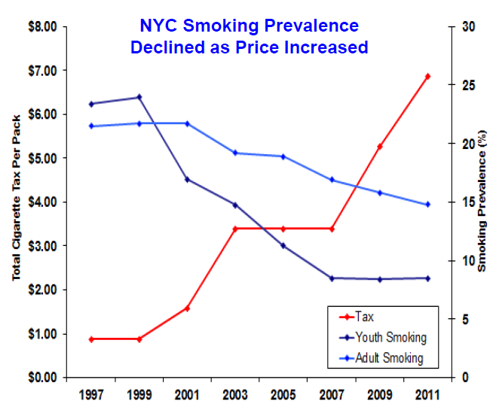
Tax Avoidance & Evasion Do NOT Eliminate Health Impact of Higher Taxes
www.tobacconomics.org | @tobacconomics
Source: Schroth, 2014

Slide 22
Tax Avoidance & Evasion
Do NOT Eliminate Revenue Impact of Higher Taxes
www.tobacconomics.org | @tobacconomics

Slide 23
www.tobacconomics.org | @tobacconomics

Slide 24
Tobacco Taxes & Illicit Trade
Governments can control illicit tobacco trade if they make it a priority and take appropriate steps
www.tobacconomics.org | @tobacconomics

Slide 25

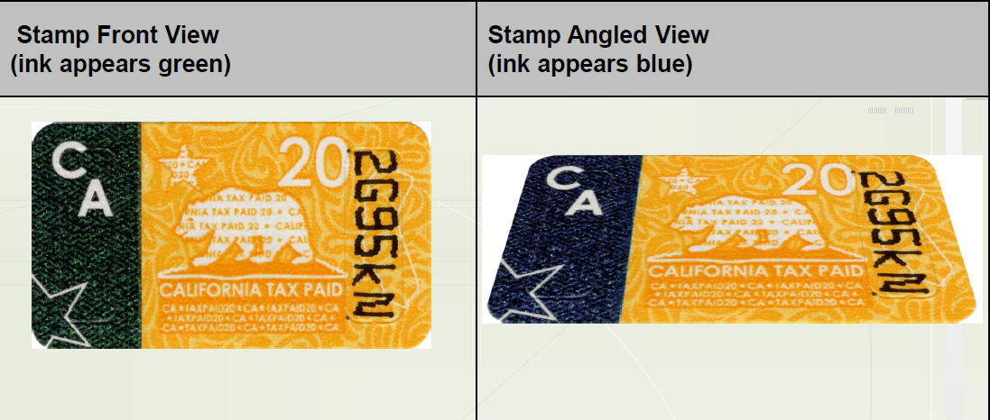
California’s Encrypted Cigarette Tax Stamps
2005-2010
2011-present
www.tobacconomics.org | @tobacconomics

Slide 26
Cigarette Tax Stamps Sold – projected and actual, California, 2000 - 2013
Source: CDC/Chaloupka et al., 2015
www.tobacconomics.org | @tobacconomics

Slide 27
Impact on the Poor
July 23, 2010 – San Francisco Examiner
“Democrats are relying more heavily in their midterm 2010 election message that Republicans care nothing about the poor. Conveniently absent from this analysis is Republican opposition to President Barack Obama’s cigarette tax increase…… While higher cigarette taxes do discourage smoking, they are highly regressive. Analyzing a slightly less severe proposal in 2007, the Tax Foundation noted that ‘no other tax hurts the poor more than the cigarette tax.’” Peyton R. Miller, special to the Examiner.
www.tobacconomics.org | @tobacconomics

Slide 28
Who Pays& Who Benefits
Impact of Federal Tax Increase, U.S., 2009
www.tobacconomics.org | @tobacconomics
Notes:
Compared with lower-income individuals (whose income is below FPL or 100-200% below FPL), higher-income individuals (whose income is greater than 200% FPL) have a larger share of the tax increase and smaller share of reduced deaths. This is because lower-income tobacco users are more price sensitive and they quit or reduce tobacco consumption more than the higher-income tobacco users.

Slide 29
Impact on the Poor
  Longer-term impact highly progressive
    Less spending on health care to treat consequences of tobacco use
    Improved health results in greater productivity, higher incomes
  Need to consider overall fiscal system
    Key issue with tobacco taxes is what’s done with the revenues generated by the tax
    Greater public support for tobacco tax increases when revenues are used for tobacco control and/or other health programs
    Net financial impact on low income households can be positive when taxes are used to support programs targeting the poor
    Concerns about regressivity offset by use of revenues for programs directed to poor
www.tobacconomics.org | @tobacconomics

Slide 30
Impact on Jobs
JULY, 14, 2010 – The Associated Press
RICHMOND, Va. — The tobacco industry is running a full-court press ahead of a federal scientific panel's meeting to discuss how to regulate menthol cigarettes, a still-growing part of the shrinking cigarette market.
The union representing nearly 4,000 tobacco workers sent a letter to the Food and Drug Administration committee examining the public health effects of the minty smokes, warning that a ban could lead to "severe jobs loss" and black market cigarettes.
www.tobacconomics.org | @tobacconomics

Slide 31
Impact on Jobs
Tobacco excise tax will lead to decreased consumption of tobacco products
  Small loss of jobs in tobacco sector
Money not spent on tobacco products will be spent on other goods and services
  Gains in jobs in other sectors
Increase in tax revenues will be spent by government
  Additional job gains in other sectors
Net increase in jobs in states like Hawaii
www.tobacconomics.org | @tobacconomics

Slide 32
Tobacco Control & Business
  Impact of smoke-free policies on hospitality sector
    No or small positive impact of smoke-free policies on bar and restaurant business (IARC Handbook 13)
  Impact of tobacco control policies on convenience stores (Huang and Chaloupka 2012)
    More business activity where cigarette taxes are higher
    No impact of smoke-free policies
    Overshifting and replacement purchase
www.tobacconomics.org | @tobacconomics

Slide 33
Vaping Product Taxation

Slide 34
Reusable E-Cigarettes
Sale Volume and Price, US 2010 - 2014

Slide 35
Impact of Price on Use of
Vaping Products
Evidence on the effects of prices on use of vaping products emerging; a few general conclusions:
  E-cigarette demand is highly responsive to price
    More responsive to price than cigarette demand
  Youth e-cigarette demand more responsive to price than youth cigarette demand
  Growing evidence of substitution between cigarettes and e-cigarettes
  No evidence on demand for heated tobacco products

Slide 36
Vaping Product Taxation
Increasing number of governments taxing vaping products
      30 countries, 27 U.S. jurisdictions have implemented or will soon implement excise or excise-like taxes on vaping products
      Rationale/objectives for taxes are often unclear
Wide variety of tax structures and tax rates
Little evidence on experiences with implementing and/or collecting taxes
Recent interviews with state/local tax administrators in jurisdictions that have imposed taxes in the U.S.
      Some preliminary recommendations based on their experiences
www.tobacconomics.org | @tobacconomics

Slide 37
Tax Structure

Slide 38
Taxing Vaping Products
Question: Ad valorem or specific tax?
    Some apply ad valorem tax
      Including: Bahrain, Indonesia, Jordan, Saudi Arabia, United Arab Emirates, and several U.S. jurisdictions (AK-Junea, MatSu Borough; CA; DC; IL; ME; MD; MN; NV; NY; PA)
    Many others apply specific
      Including: Albania, Azerbaijan, Croatia, Cyprus, Estonia, Finland, Georgia, Greece, Hungary, Italy, Kazakhstan, Kyrgyzstan, Kenya, Latvia, Lithuania, Montenegro, Philippines, Poland, Portugal, Romania, Russia, Serbia, Slovenia, Sweden, and several U.S. jurisdictions (Chicago, Cook County IL, DE, KS, LA, NC, OH, WA, WV, WI)
        Some automatic increases for inflation (Kyrgyzstan, Philippines)
www.tobacconomics.org | @tobacconomics

Slide 39
Taxing Vaping Products
Question: Ad valorem or specific tax?
    Some apply mixed or differential tax
      South Korea: KRW 1799.2572/ml plus KRW 24.4/20 cartridges
      Chicago: specific tax per unit ($1.50) AND specific tax based on volume of vaping solution ($1.20/ml)
      New Jersey: $0.10/ml nicotine liquid OR 10% retail price for container e-liquids
      New Mexico: 12.5% of manufacturer price for nicotine liquid OR $0.50/cartridge
      Washington: $0.27/ml (≤ 5ml container) OR $0.09/ml (>5 ml container)
  My view: apply uniform ad valorem tax
      Helps minimize differences in taxes based on types of product
      Simpler to administer than more complex tiered/differential tax structures
www.tobacconomics.org | @tobacconomics

Slide 40
Taxing Vaping Products
Question: If ad valorem, applied on what price?
    Some apply on retail price
      Indonesia: 57% of tax-inclusive retail price
      Bahrain (200%), Saudi Arabia (100%) and UAE (100%) of pre-tax retail price
      New York: 20% ‘special sales tax’ on retail price
    Others apply to wholesale/distributor price
      Most U.S. jurisdictions apply to wholesale or distributor price
  My view: apply based on tax-inclusive retail price
      Minimizes some types of tax avoidance
      Reduces challenges resulting from non-traditional distribution chains
      Tax appears in shelf price
www.tobacconomics.org | @tobacconomics

Slide 41
Taxing Solutions, Devices, and/or Components Used in Vaping Products

Slide 42
Taxing Vaping Solutions
Question: Tax all liquids or just those that contain nicotine?
    Some tax any liquid used for vaping
      Including: Azerbaijan, Croatia, Cyprus, Estonia, Finland, Georgia, Greece, Hungary, Italy, Kazakhstan, Kenya, Latvia, Lithuania, Montenegro, Philippines, Poland, Russia, Saudi Arabia, Serbia
      Kansas, North Carolina, New York, Washington
    Others tax only liquids containing nicotine
      Including: Albania, Bahrain, Indonesia, Jordan, Krygyzstan, Portugal, Romania, Slovenia, Sweden
      Most U.S. states/localities that tax
  My view: tax all liquids used in vaping
      Eliminates need for taxing authority to determine whether or not product contains nicotine
www.tobacconomics.org | @tobacconomics

Slide 43
Taxing Vaping Solutions
Question: Differential tax based on nicotine content?
    Most apply same tax regardless of nicotine content
    Some apply differential tax based on nicotine content
      Italy: €0.082074/ml if contains nicotine; €0.041037/ml if no nicotine
      Latvia: €0.01/ml plus €0.005/mg nicotine
  My view: do not tax based on nicotine content
      Simplifies tax administration by eliminating need for taxing authority to determine nicotine concentration
www.tobacconomics.org | @tobacconomics

Slide 44
Taxing Vaping Solutions
Question: Tax products with any nicotine or with nicotine derived from tobacco?
    Unclear for most
    Some clearly apply to only nicotine derived from tobacco
      Indonesia: applies to ‘extracts and essences of tobacco’
      Minnesota: applies definition of other tobacco products, which includes products containing nicotine derived from tobacco
  My view: if taxing only products containing nicotine, tax all regardless of source of nicotine
      Eliminates need for taxing authority to determine whether or not nicotine is derived from tobacco, other plants, or synthetic
www.tobacconomics.org | @tobacconomics

Slide 45
Taxing Vaping Devices
Question: Tax devices/components or not?
    Most governments do not apply unique tax on devices
    Some do tax devices:
      Kenya: KSH 3,000/device; Jordan: 200% sales tax on devices and paraphernalia; Russia: RUB 48/device; Saudi Arabia: 100% of retail price; Several US states/localities: ‘any product containing or delivering nicotine’
    A few with ad valorem taxes apply to devices only if they include vaping solution:
      California (59.27%) and Illinois (15%) of wholesale price for nicotine liquid or product containing nicotine liquid
      Minnesota: 95% of wholesale price (but trying to separately determine value of liquid only)
  My view: do not tax devices/components
      Adds complications to tax administration, given diversity of devices and ability of users to make their own
      If ad valorem, then tax devices that contain vaping solution (e.g. disposable e-cigarettes, starter kits)
www.tobacconomics.org | @tobacconomics

Slide 46
Taxing Vaping Products
-
Other Issues

Slide 47
Taxing Vaping Products
Question: Where to collect?
    Manufacturer/Importer?
    Distributor?
    Retailer?
    Varied approaches in different jurisdictions
    Complicated by non-traditional distribution chains
      Many products go directly from manufacturer or importer to retailer
      Retailer can also be manufacturer
      Significant share of online sales
  My view – collect from retailers (including online vendors) given challenges associated with non-traditional distribution chains
www.tobacconomics.org | @tobacconomics

Slide 48
Taxing Vaping Products
Question: What tax rate/level?
  Enormous variability in tax rates
    In U.S., specific taxes range from $0.05/ml (DE, KS, LA, NC, WI) to $1.20/ml + $1.50/unit in Chicago; ad valorem range from 15% (IL) to 96% (DC)
    Similar variability globally
    Some with zero rate (Croatia, Kazakhstan)
  Considerable variability relative to taxes on cigarettes
    Some governments aim to tax equivalently (e.g. CA, MN)
    Fewer tax at higher effective rates (e.g. Indonesia)
    Most tax at lower rates
    Rationale for relative rates unclear
My view – tax parity with cigarettes
    If/when FDA determines that a products is a modified risk tobacco products, implying a significant public health benefit, then tax at a lower rate (e.g. Connecticut taxes MRTPs at 50% of cigarette tax rate)
www.tobacconomics.org | @tobacconomics

Slide 49
Taxing Vaping Products
Question: What is the revenue potential?
  Revenue replacement often used as argument for taxing vaping products
  But revenue potential is small in most jurisdictions
    Relatively low use
    Data on revenues from vaping product taxes are very difficult to obtain
    Where data are available, suggest that revenues are minimal
      CA: nearly $1.9 billion from cigarette taxes vs. ~$32 million from vaping taxes
      MN: $525 million from cigarettes; $11 million from vaping taxes
My view – if revenue generation/replacement is objective, raise taxes on cigarettes when implementing vaping product taxes
www.tobacconomics.org | @tobacconomics

Slide 50
Summary and Potential
Impact of Tax Increase

Slide 51
Summary
Increases in tobacco product taxes and prices lead to significant reductions in tobacco use
Claims of negative economic impact of tax and price increases and other effective tobacco control measures are false or greatly exaggerated
Taxation of vaping products would affect their use, but many challenges in tax administration
www.tobacconomics.org | @tobacconomics

Slide 52
THANK YOU!
For more information:
Tobacconomics
http://www.tobacconomics.org
@tobacconomics
fjc@uic.edu
Notes:
52

